Slide 1
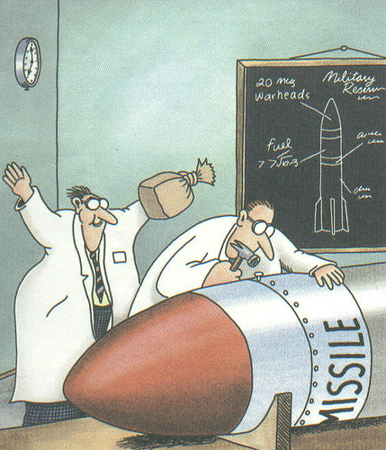
Factors Affecting Reaction Rates

Slide 2
Factors Affecting Reaction Rates:
Nature:
Reactions with strong bonds (covalent) → slower reactions
Reactions with weaker bonds (ionic) →
faster reactions

Slide 3
Factors Affecting Reaction Rates:
2. Concentration:
As concentration increases, reaction rate increases.
*More collisions of molecules
For gases → as pressure increases, concentration increases

Slide 4
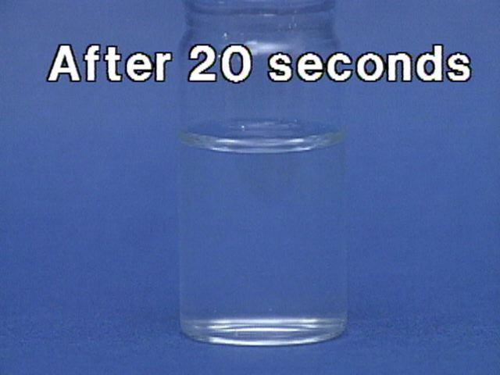
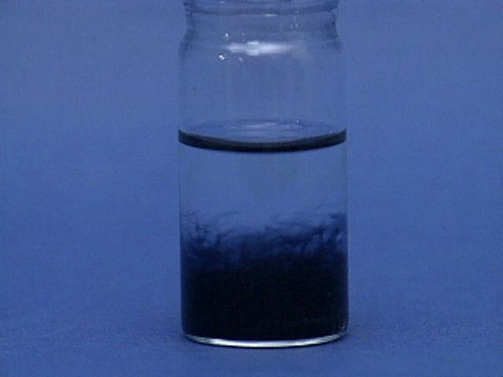
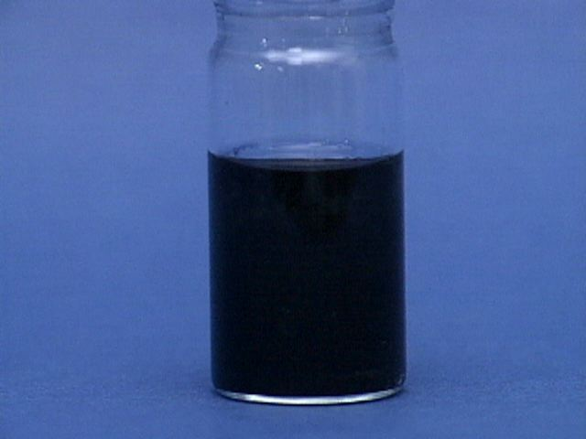
Iodine Clock Video Link

Slide 6
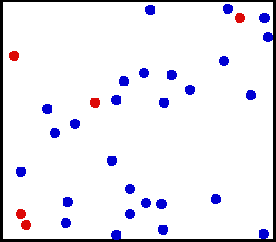
Factors Affecting Reaction Rates:
3. Temperature:
As temperature increases, reaction rate increases.
*more collisions
*more effective collisions
→ collisions with more energy
*Rule of thumb: reaction rate doubles for every 10°C

Slide 7
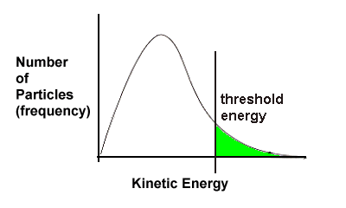
T1 represents the energy distribution at the lower temperature.
T2 is the distribution at the higher temperature.
The threshold energy is unchanged, but for the new curve (T2) more particles will be above the threshold energy, and thus will have successful reactions.

Slide 8
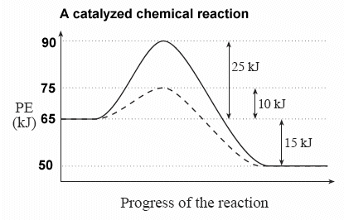
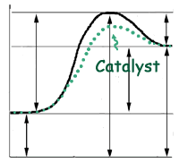
Factors Affecting Reaction Rates:
4. Catalyst:
Speeds up a reaction, but doesn’t get used up.
*Lowers the activation energy
*Does Not change heat of reaction, ∆H

Slide 9
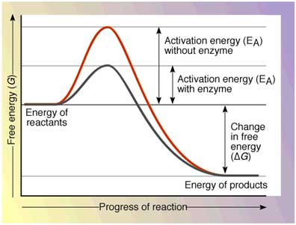
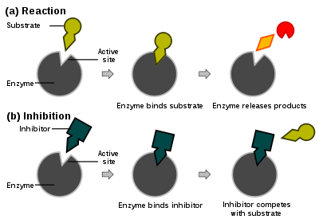
Enzymes: organic catalysts
Inhibitor: slows down reaction rate

Slide 10
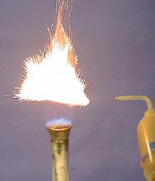
Factors Affecting Reaction Rates:
5. Particle Size / Surface Area:
As particle size increases, surface area decreases, and reaction rate decreases.
As particle size decreases, surface area increases, and reaction rate increases.
An iron bar is held in a flame and nothing happens. Iron powder is blown into the flame and ignites.
Lycopodium Powder Flame Thrower Link

Slide 11
A = Potential Energy of Reactants
B = Activation Energy
C = Potential Energy of Activated Complex
D = Potential Energy of Products
E = ∆H or Heat of Reaction
E

