Slide 1
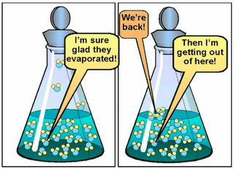
Equilibrium

Slide 2
Equilibrium Activity
Does equilibrium mean that the amounts of reactants and products are equal?
Materials:
Obtain two straws, a 50 mL graduated cylinder and a 100 mL beaker.

Slide 3
Procedure:
Place 20 mL of water in the graduated cylinder.
Place a straw in the graduated cylinder and one in the beaker.
Seal the tops of the straws with your fingers.
Lift the straws and transfer any water in the straws to the other piece of glassware.
Repeat steps 2 through 4 25 times and observe what happens to the amount of water in each piece of glassware.

Slide 4
Questions
How can your observations be explained?
What does this tell you about the concept of equilibrium?

Slide 5
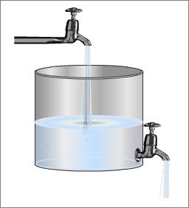
Chemical Equilibrium
Rate of the forward reaction equals the rate of the reverse reaction.
Both the forward and reverse reactions continue to take place, but there is no change in the concentrations of reactants and products.

Slide 6
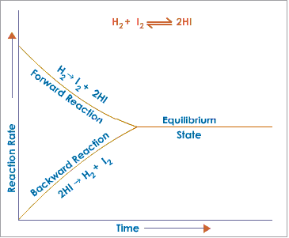
rate of forward rxn = rate of reverse rxn

Slide 7
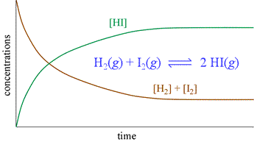
Chemical Equilibrium
2. Concentration of reactants and products don’t change.
Equilibrium

Slide 8
Reaction with Catalyst
Catalyst causes reaction to speed up forward and reverse reaction equally.
Equilibrium is reached faster.

Slide 9
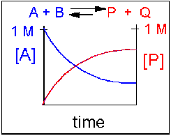
Chemical Equilibrium
3. Concentration of reactants and products are NOT equal.

Slide 10
The point at which equilibrium is reached is when the number of fish swimming from the left tank to the right tank is equal to the number of fish swimming back.
Equilibrium is reached, but concentrations are not equal.

