Slide 1
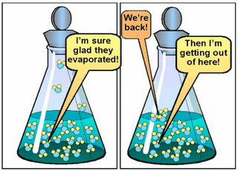
Phase Equilibrium

Slide 2
Equilibrium:
Two opposing processes go on at the same time and at the same rate.

Slide 3
Phase Equilibrium:
Equilibrium between two different phases of matter:
Solid Liquid
Liquid Gas

Slide 4
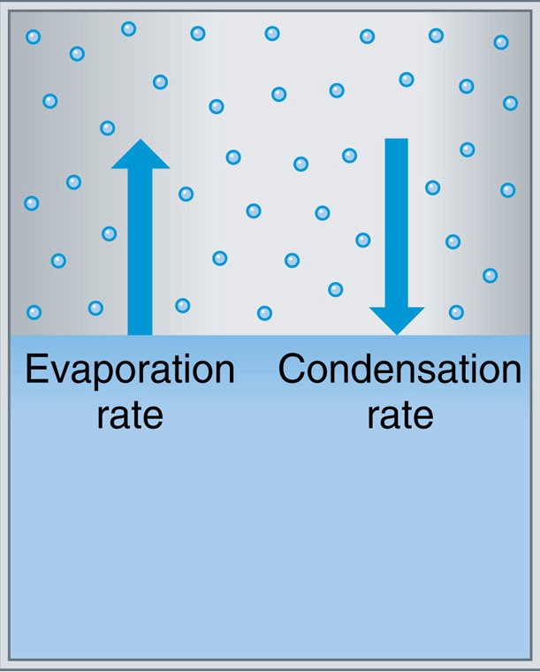
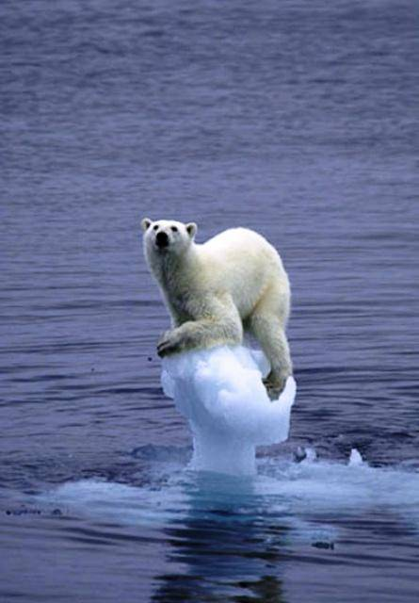
Phase Equilibrium
Condensation = Evaporation
Rate Rate
Melting Rate = Freezing Rate

Slide 5
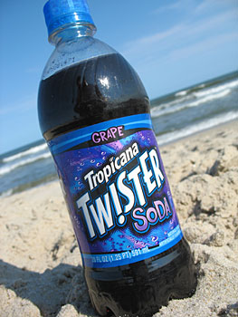
Solution Equilibrium
Rate Leaving Solution = Rate Entering Solution
Closed Bottle: CO_{2(g)} CO_{2(aq)}

Slide 6
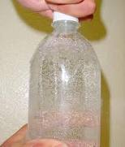
Open the bottle, decrease the pressure
CO_{2(g)} CO_{2(aq)}

Slide 7
Phase Equilibrium
Dissolving Rate = Crystallization Rate
NaCl_{(s)} Na⁺_{(aq)} + Cl⁻_{(aq)}

Slide 8
Learning Check
When a seltzer bottle is opened, the mixture begins to fizz as the carbon dioxide comes out of solution. What happens when the bottle is resealed? Explain.

