Slide 1
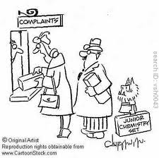
Factors Affecting Equilibrium

Slide 2
Equilibrium:
Once equilibrium has been reached, it can only be changed by factors that affect the forward and reverse reactions.
Catalyst has NO effect on equilibrium
Catalysts speed the forward and reverse reaction equally.
Allows reaction to reach equilibrium in a shorter time.
Changes in concentration, pressure (gas), and temperature will shift equilibrium.

Slide 3
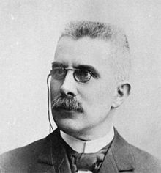
LeChatelier’s Principle:
Systems under stress shift to relieve the stress and restore equilibrium.
Stress: a change on the system at equilibrium.
Concentration
Temperature
Pressure (gases only)

Slide 4
Concentration
As concentration increases, collisions increase, causing an increase in rate of reaction.
SO₃ + NO SO₂ + NO₂
What happens to the concentrations and rate of reaction when additional NO is added?
SO₃ + NO SO₂ + NO₂
*Equilibrium shifts to the right. Products increase, SO₃ decreases concentration.

Slide 5
Suppose that when the reaction mixture had reached equilibrium, some more reactants are added? This is a stress on the system, which can be relieved by using up these reactants to form products, in order to form a new equilibrium.

Slide 7
Learning Check
CO + 3H₂ CH₄ + H₂O
What happens to equilibrium and concentration if you add more CO?
Equilibrium shifts to the right yielding more products, and less H₂ (gets used up)

Slide 8
Learning Check
N₂ + 3H₂ 2NH₃
What happens to equilibrium and concentration if you add more NH₃?
Equilibrium shifts to the left yielding increased concentration of reactants.

Slide 9
Equilibrium Constant K_{EQ}
N₂ + 3H₂ 2NH₃
Forward Rate = K [N₂] [H₂]³
Reverse Rate = K [NH₃]²
Forward Rate = Reverse Rate
K_{f} [N₂] [H₂]³ = K_{r} [NH₃]²
K_{EQ} = [NH₃]²
[N₂] [H₂]³

Slide 10
Equilibrium Constant K_{EQ}
General Formula:
aA + bB cC + dD
K_{EQ} = [C]^{c} [D]^{d}
[A]ª [B]^{b}
K_{EQ} = Products
Reactants

Slide 11
Learning Check
N₂O₄ 2NO₂
K_{EQ} = [NO₂]²
[N₂O₄]
2H₂S 2H₂ + S₂
K_{EQ} = [H₂]² [S₂]
[H₂S]²

Slide 12
Signifigance of K_{EQ}
K_{EQ} = Products
Reactants
If K_{EQ} >1 → products are favored
(Eq shifts right)
If K_{EQ} <1 → reactants are favored
(Eq shifts left)
**The only thing that changes K_{EQ} is temp.

