Slide 1
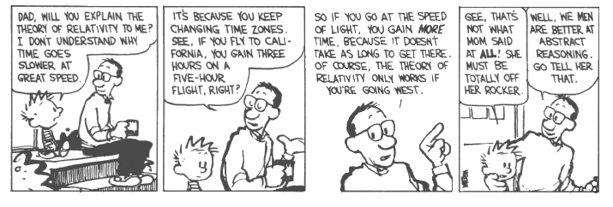
LeChatelier’s Principle: Pressure & Temperature

Slide 2
LeChatelier’s Principle
At equilibrium, the rate of the forward reaction is equal to the rate of the reverse reaction.
Systems under stress shift to relieve the stress and restore equilibrium.
Causes of stress = change of:
Concentration
Temperature
Pressure (gases only)

Slide 3
Pressure
Gases only
Increase pressure = Decrease volume

Slide 4
Pressure and Equilibrium:
1. Increase in pressure favors the direction that produces a smaller number of moles of gas (less volume).
A + B AB
Reactants = 1 mol A + 1 mol B
Products = 1 mol AB
2 moles of gas react to form 1 mole of gas
Increasing pressure will drive reaction to the right, favoring product formation because it has the smaller # of moles.

Slide 5
Animation

Slide 6
Decrease in pressure favors the direction that produces a larger number of moles (larger volume).
N₂ + 3H₂ 2NH₃
Reactants = 4 moles
Products = 2 moles
Decrease in pressure will favor the reverse reaction since there are 4 moles of reactants and 2 moles of products.

Slide 7
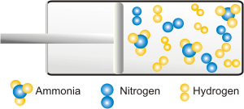
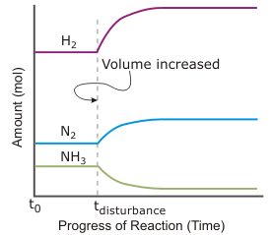
Decreased Pressure
Equilibrium shifts left.
Reactants are favored.

Slide 8
Change in pressure has no effect on equilibrium if there are an equal number of moles of reactants and products.
Reactants = I mol H₂ + 1 mol I₂ = 2 mol
Products = 2 mol HI
Since both the reactants and products have the same volume, no shift in reaction will occur if the pressure is changed.
*Same # of particles on both sides.

Slide 9
Change in pressure does not change the equilibrium constant – K_{EQ}
The position of equilibrium may be changed by pressure, but the equilibrium constant will not be changed.

Slide 10
Temperature and Equilibrium
Increasing the temperature causes more frequent, and more intense collisions between particles, causing faster reaction rates.
Increasing temperature favors the endothermic reaction.
**Change in temperature does change the equilibrium constant (K_{EQ})

Slide 11
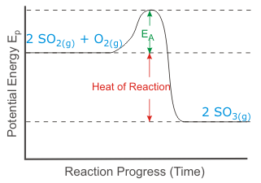
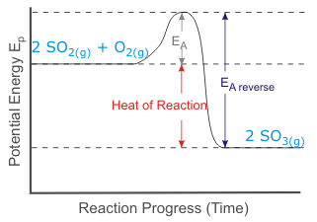
Forward Reaction = Exothermic
Small Activation Energy
Reverse Reaction = Endothermic
Larger Activation Energy

Slide 12
H₂ + Br₂ 2HBr₂ + heat
Endothermic (absorbs heat)
Increase temperature, endothermic reaction increases, reactant concentration increases.
Exothermic (gives off heat)

Slide 13
Increase temperature:
CO + 3H₂ CH₄ + H₂O + 206.5KJ
Reaction will shift to the left
Concentrations of CO and H₂ increase

Slide 14
Increase temperature:
N₂O₂ + heat 2NO
Reaction will shift to the right
Concentration of NO will increase

Slide 15
Haber Process
N₂ + 3H₂ 2NH₃ + 92KJ
How can more NH₃ be produced?
Increase concentration of N₂ or H₂
Remove NH₃ from container
Increase pressure
Temperature – high enough to speed up reaction while keeping K_{EQ} high
Add a catalyst to reach equilibrium quickly

Slide 16
Learning Check (all gases)
CO + Cl₂ COCl₂ + heat
Add Cl₂
Remove CO
Add COCl₂
Increase pressure
Increase temperature

Slide 17
Learning Check (all gases)
H₂O + CO H₂ + CO₂
Add H₂
Remove CO
Add H₂O

Slide 18
Learning Check (all gases)
N₂O₂ + heat 2NO₂
Increase pressure
Increase temperature

